Slide 1


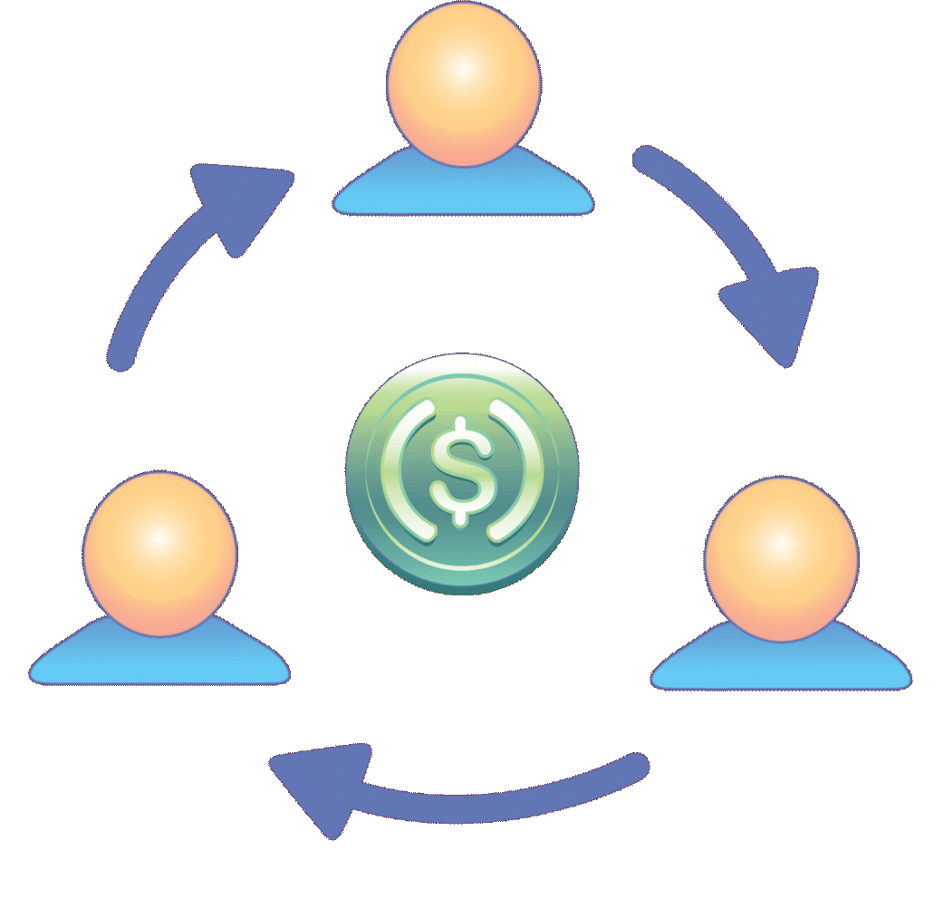

FINANCIAL (EXPENSE) MANAGEMENT APPLICATION
CSE1021
COURSE:- Introduction to Problem Solving and Programming
Team members:
Dhanraj Choudhary [25BCE10624]
• Palak Roy [25BAI11268]
• Shruti Mishra [25BCY10042]
• Kumari Laxmi [25BCY10206]
• C Sahasra Lakshmi [25BCY10241]

Slide 2

Problem Statement & Objective
The Financial Blind Spot: Why We Need a Digital Money Notebook?
THE PROBLEM:
No expense tracking → Overspending
Manual methods → Time-consuming & error-prone
Poor visibility → Bad financial desicions
WHY THIS APP?
Real-time tracking & automated calculations
Smart categorization & spending insights
Accessible financial management for everyone
BENEFITS:
Students → Manage pocket money effectively
Professionals → Budget salaries & track savings
Families → Plan household finances
Everyone → Build financial literacy

Slide 3

Project Features and Current Status
FEATURE | CORE FUNCTIONALITY | STATUS
Add, update, delete income/expense | Complete transaction management with edit and remove capabilities | PENDING
Categorization | Automatic sorting into Food, Transport, Bills, Entertainment, Shopping, and custom categories | PENDING
Summaries and reports | Total income, total expenses, remaining balance, and category-wise analysis | PENDING
Data storage | Persistent storage using JSON files for reliable data retention | PENDING
Search option | Find transactions by date, category, amount, or description | PENDING

Slide 4


TECHNICAL IMPLEMENTATION
DATA STORAGE
JSON (JavaScript Object Notation)
Lightweight & human-readable format
No complex database setup needed
Easy Python integration
Future: SQLite for scalability
PROGRAMMING LANGUAGE
Python 3.x
Beginner-friendly with readable syntax
Built-in file handling & data processing
Large community + extensive resources
Cross-platform compatibility (Windows, Mac, Linux)
USER INTERFACE
Console/CLI (Command Line Interface)
Text-based menu system
Platform-independent & simple
Focuses on functionality first
Future: GUI(Tkinter) or Web interface

Slide 5



SYSTEM DESIGN
MODULES PLANNED:
Flowchart:
INPUT MODULE: USER INPUT HANDLING, VALIDATION, ERROR CHECKING
REPORT MODULE: SUMMARY GENERATION, CATEGORY ANALYSIS, TREND CALCULATIONS
STORAGE MODULE: JSON FILE READ/WRITE, DATA PERSISTENCE, BACKUP
UI MODULE: MENU DISPLAY, RESULT PRESENTATION, USER FEEDBAC
Block Design

Slide 6
CURRENT PROGRESS:
Editing and deleting –pending
Status: Feature specifications ready, implementation Week 4
View all transactions functionality planned
Selection mechanism designed (by ID or date)
Confirmation prompts planned for delete operations
Adding an expense entry – not working
Status: Design pending, implementation pending
Menu option structure define
Input flow designed (amount, category, description)
Validation rules planned (positive amounts, valid categories)
JSON storage format designed
Summary calculation – not tested
Status: Algorithm designed, testing pending Week 5-6
Calculation formulas ready: Income - Expenses = Balance
Category-wise aggregation logic defined
Report formatting structure planned

Slide 7
CURRENT PROGRESS
Screenshots of UI done - pending
Code modules completed - pending
Data storage implementation - pending
Working demo (if possible) - pending

Slide 8
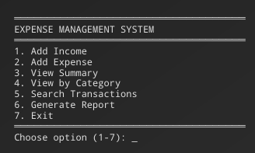
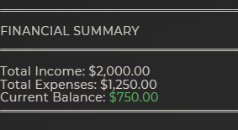
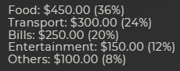
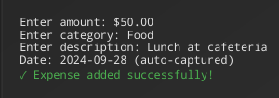
SAMPLE OUTPUT
1. Main Menu:
3. Financial summary:
4. Category-wise report:
2. Add Expense Example:
Note: Full working demo will be available at later stages of development

Slide 9
CHALLENGES FACED
TECHNICAL LEARNING-
LOGIC AND ERROR-HANDLING -
Python fundamentals - syntax, functions, logic
File handling & JSON data structures
Development environment setup
Input validation ( negative amounts, empty fields)
Edge cases (duplicates, missing data)
Currency precision & user-friendly error messages
DATA MANAGEMENT-
TEAM COORDINATION -
Preventing data loss between sessions
Reliable file read/write without corruption
Cross-platform file path compatibility
Different learning paces & workload balance
Module division and integration
Scheduling meetings & maintaining communication

Slide 10

THANK YOU!

